Slide 1

Chapter 15
Transmission
Control
Protocol
(TCP)
TCP/IP Protocol Suite
Copyright © The McGraw-Hill Companies, Inc. Permission required for reproduction or display.

Slide 2

OBJECTIVES:
To introduce TCP as a protocol that provides reliable stream delivery service.
To define TCP features and compare them with UDP features.
To define the format of a TCP segment and its fields.
To show how TCP provides a connection-oriented service, and show the segments exchanged during connection establishment and connection termination phases.
To discuss the state transition diagram for TCP and discuss some scenarios.
To introduce windows in TCP that are used for flow and error control.
TCP/IP Protocol Suite

Slide 3

OBJECTIVES (continued):
To discuss how TCP implements flow control in which the receive window controls the size of the send window.
To discuss error control and FSMs used by TCP during the data transmission phase.
To discuss how TCP controls the congestion in the network using different strategies.
To list and explain the purpose of each timer in TCP.
To discuss options in TCP and show how TCP can provide selective acknowledgment using the SACK option.
To give a layout and a simplified pseudocode for the TCP package.
TCP/IP Protocol Suite

Slide 4
Chapter
Outline
15.1 TCP Services
15.2 TCP Features
15.3 Segment
15.4 A TCP Connection
15.5 State Transition Diagram
15.6 Windows in TCP
15.7 Flow Control
15.8 Error Control
15.9 Congestion Control
15.10 TCP Timers
15.11 Options
15.12 TCP Package
TCP/IP Protocol Suite

Slide 5
15-6 WINDOWS IN TCP
Before discussing data transfer in TCP and the issues such as flow, error, and congestion control, we describe the windows used in TCP. TCP uses two windows (send window and receive window) for each direction of data transfer, which means four windows for a bidirectional communication. To make the discussion simple, we make an assumption that communication is only unidirectional; the bidirectional communication can be inferred using two unidirectional communications with piggybacking.
TCP/IP Protocol Suite

Slide 6
Topics Discussed in the Section
Send Window
Receive Window
TCP/IP Protocol Suite

Slide 7
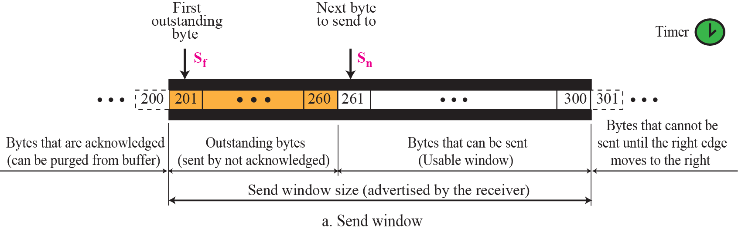
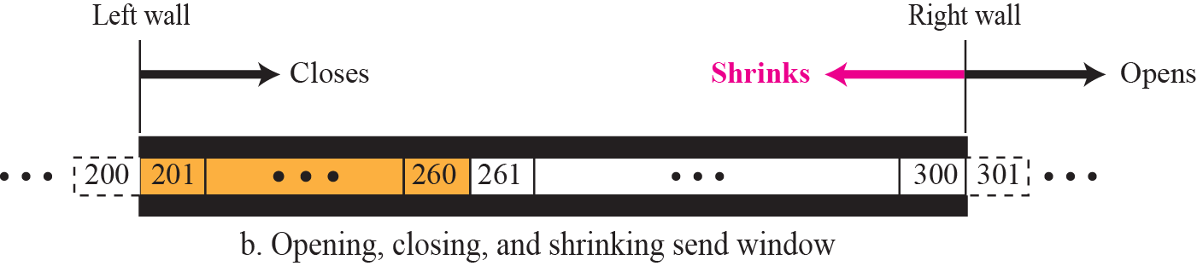
Figure 15.22 Send window in TCP
TCP/IP Protocol Suite

Slide 8
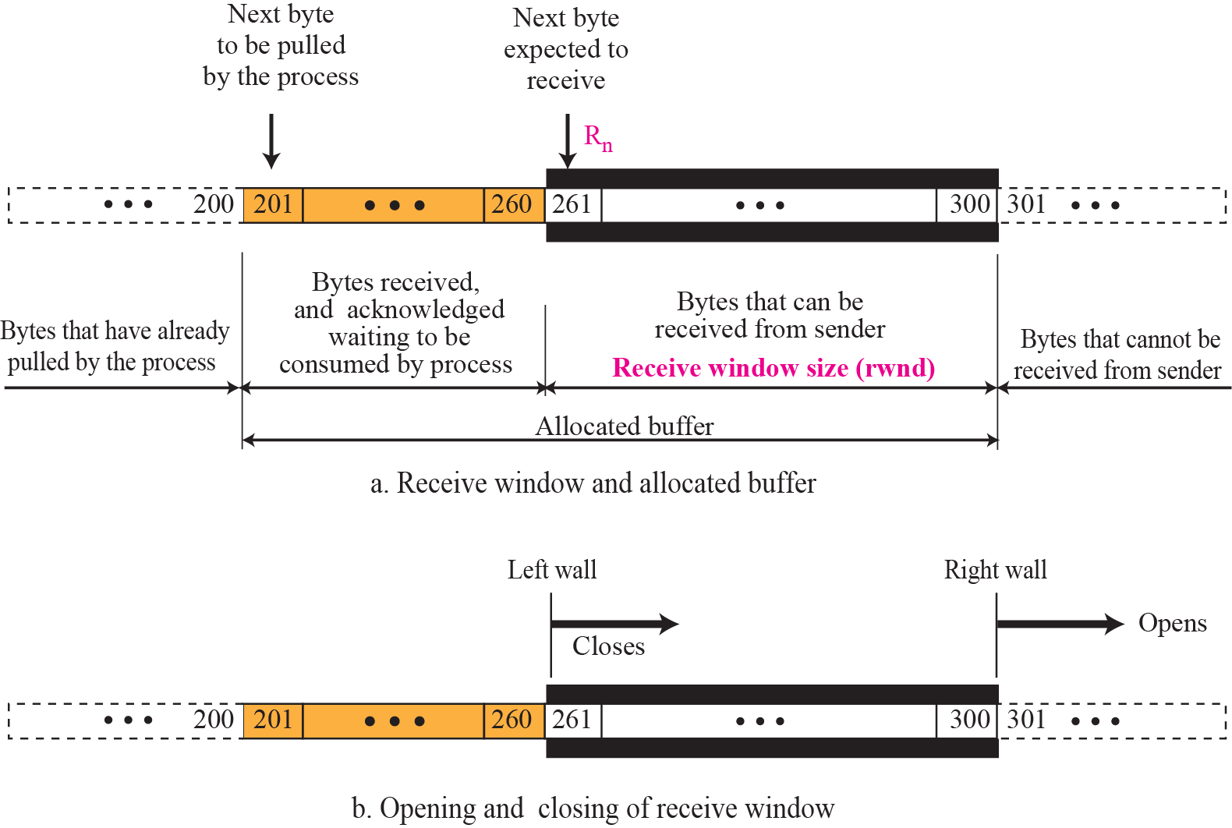
Figure 15.23 Receive window in TCP
TCP/IP Protocol Suite

Slide 9
15-7 FLOW CONTROL
As discussed in Chapter 13, flow control balances the rate a producer creates data with the rate a consumer can use the data. TCP separates flow control from error control. In this section we discuss flow control, ignoring error control. We temporarily assume that the logical channel between the sending and receiving TCP is error-free. Figure 15.24 shows unidirectional data transfer between a sender and a receiver; bidirectional data transfer can be deduced from unidirectional one as discussed in Chapter 13.
TCP/IP Protocol Suite

Slide 10
Topics Discussed in the Section
Opening and Closing Windows
Shrinking of Windows
Silly Window Syndrome
TCP/IP Protocol Suite

Slide 11
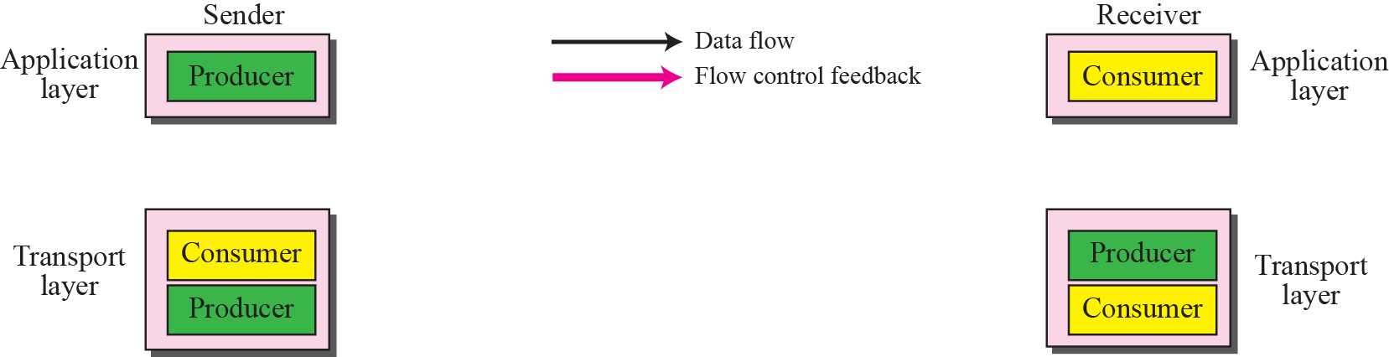
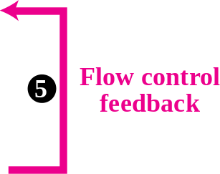
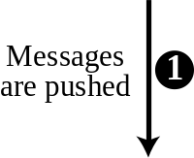
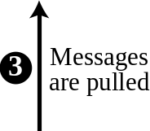

Figure 15.24 TCP/IP protocol suite
TCP/IP Protocol Suite

Slide 12
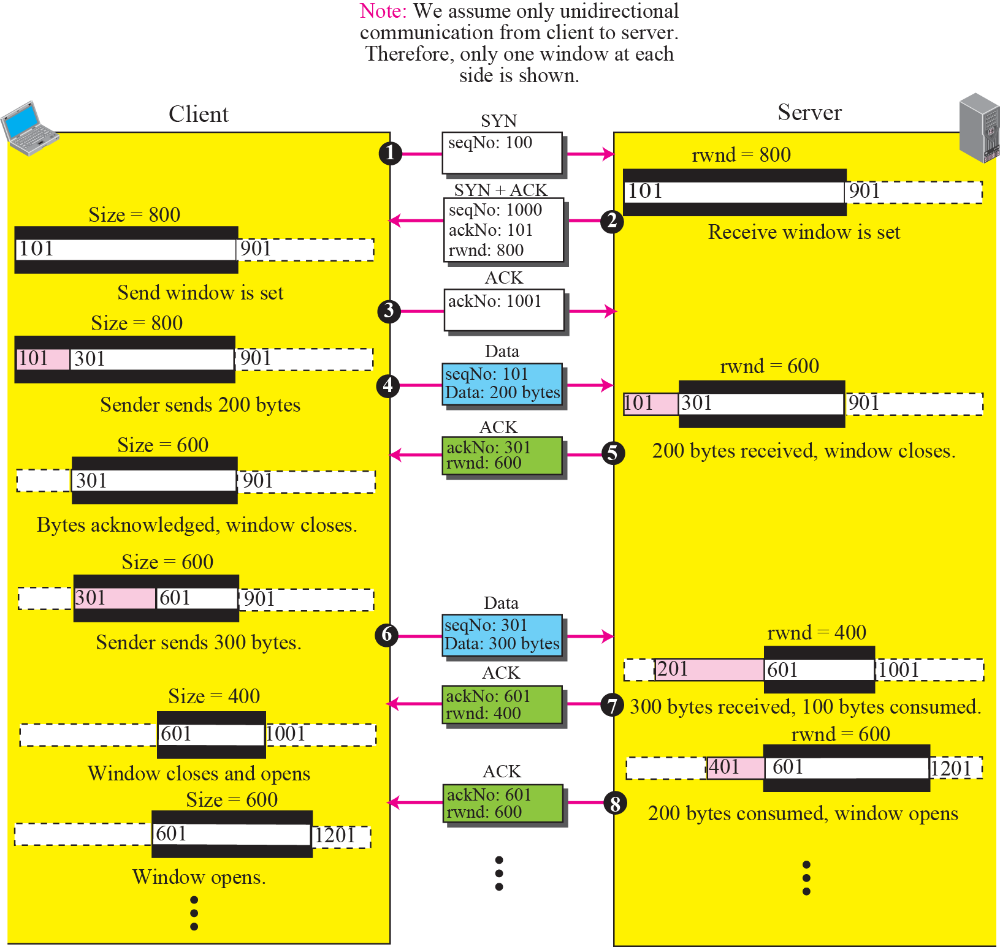
Figure 15.25 An example of flow control
TCP/IP Protocol Suite

Slide 13
Figure 15.25 An example of flow control
TCP/IP Protocol Suite

